Slide 1
Configuring Apache

Slide 2
Introduction
A web server is server software, or hardware dedicated to running this software, that can satisfy client requests on the World Wide Web. A web server can, in general, contain one or more websites. A web server processes incoming network requests over HTTP and several other related protocols
The primary function of a web server is to store, process and deliver web pages to clients.
The communication between client and server takes place using the Hypertext Transfer Protocol (HTTP). Pages delivered are most frequently HTML documents, which may include images, style sheets and scripts in addition to the text content.

Slide 3
A basic web server works as follows :
It is a program that runs on a host computer .
It waits for a request from web browser/client for objects it has in its possession
Upon receiving the request (GET command from client), it retrieves the requested information and sends it to the client.

Slide 4
Creating a Basic Website
1. Use yum -y install httpd to install the Apache web server.
2. Use chkconfig httpd on to put the Apache web server in your server’s runlevels.
3 .Open a root shell, and go to the directory /var/www/html. In this directory, create a file with the name index.html. In this file, put the content “ welcome to my website” and then use service httpd start to start the Apache web server.
4. Still from the root shell, use elinks http://localhost to access the website you just created.

Slide 5
Understanding the Apache Configuration Files
the configuration of your Apache server is in the /etc/httpd directory.
In this directory, you’ll find two subdirectories: conf and conf.d
httpd.conf file is designed to contain the entire Apache configuration.

Slide 6
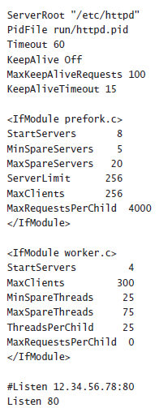
Example httpd.conf file

Slide 7
Generic Parameters
ServerRoot is important directive. This defines the root of the configuration directory. by default the server root is set to /etc/httpd.
PidFile (a file that contains the PID of the httpd process)is located in /etc/httpd/run/httpd.pid.
Httpd listen at port 80.
User and Group, which specify the user and group that should be used to run the Apache server. By default, both are set to apache.
Another directive is the DocumentRoot -Documents that are stored in the DocumentRoot are served by default.

Slide 8
Apache Mode
prefork mode
In this mode, a master httpd process is started,and this master process will start different httpd servers . prefork mode is used as default.
worker mode
one httpd process is active, and it uses different threads to serve client requests

Slide 9
Performance parameters of both nodes
StartServers- This is the number of server processes httpd should always start.
MinSpareServers- This is the minimum amount of spare server processes that are kept.
MinSpareThreads- In worker mode, this is the minimum amount of spare threads that httpd should keep.
MaxSpareServers and MaxSpareThreads- This is the maximum amount of spare servers or threads that httpd should keep.
ServerLimit- This is the total amount of server processes that can be started as a maximum
MaxClients- This is the maximum number of clients that can be connected
MaxRequestPerChild- This is the number of requests that can be opened by a server process.In prefork mode, the maximum is capped at 4,000

Slide 10
Modules
By including modules, functionality can be added to Apache. To include Apache modules, they first need to be installed in /etc/httpd/modules directory.
To load a specific module, you need to use the LoadModule directive.
To load additional configurations for modules:
Use the IfModule directive in httpd.conf.
Put it in an include file.
If a module is common, its parameters can be entered in httpd.conf

Slide 11
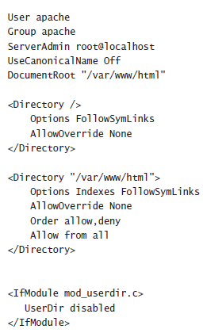
Setting Directory Options

Slide 12
Setting Directory Options
These options are used to define how the contents of a directory on the httpd server should be presented to users who access that directory.
By default, the DirectoryIndex directive specifies that Apache should look for a file with the name index.html or index.html.var
Apache Log Files
Two log files are used by default.
access_log file
error_log file

Slide 13
Basic Directory Restrictions
To handle access restrictions is by using the Order directive.
The default order is deny and then allow
order allow, deny
allow from 10.100
deny from all
In this line, the allow rules are read first and give access to any host that has an IP address starting with 10.100.
the deny line that denies access to all, the site would be closed, even for devices that have an IP address starting with 10.100
order deny, allow
allow from 10.100
deny from all

Slide 14
Working with Virtual Hosts
One Apache installation can handle more than one Apache website.
To handle more than one site from an Apache server, you can create virtual hosts .
A virtual host is a definition of different websites to be served by the Apache web server. You can include this definition in the main Apache configuration file /etc/httpd/conf/httpd.conf

Slide 15


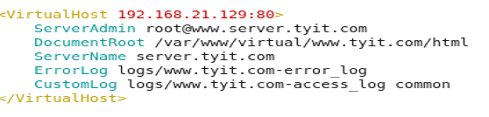

Slide 16
Securing the Web Server with TLS Certificates
TLS security guarantees that sensitive data can be encrypted while in transit.
To use TLS we need mod_ssl.
After installing mod_ssl, you’ll find its configuration file ssl.conf in the /etc/httpd/conf.d

Slide 17
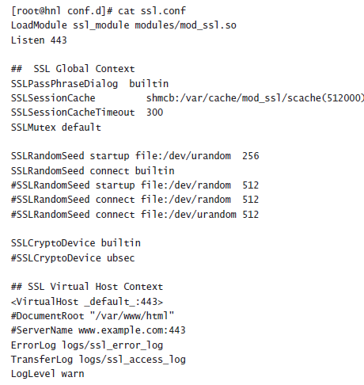

Slide 18
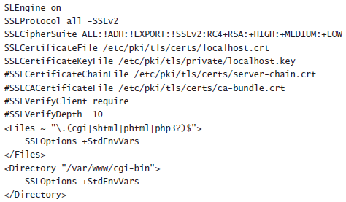

Slide 19
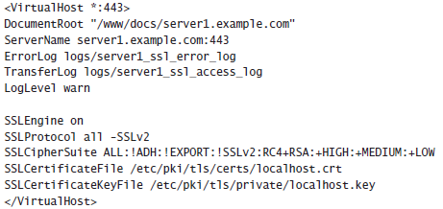
1.Open a root shell, and use cd to go to the directory /etc/httpd/conf.d. In this directory, create a file with the name server1_ssl.conf

Slide 20
2.Use service httpd restart to restart Apache..
3. Start a browser, and enter the URL https://server1.example.com. You will get a message that the connection is untrusted.
4. Use yum -y install crypto-utils to install the genkey utility on your server.
Next, use genkey server1.example.com to start the genkey utility

Slide 21
5 .At this point you’ve generated a key pair that at least matches the name of your server. Open the /etc/httpd/conf.d/server1_ssl.conf file again with an editor
SSLCertificateFile /etc/pki/tls/certs/server1.example.com.crt
SSLCertificateKeyFile /etc/pki/tls/private/server1.example.com.key
6. Use the command service httpd restart
7. Use your browser to connect to https://server1.example.com again.

Slide 22
Configuring Authentication
To configure Apache to allow access only to specific users
htpasswd -cm /etc/httpd/.htpasswd linda
htpasswd -m /etc/httpd/.htpasswd leo
the first line creates the file (option -c) and adds a user linda with an MD5 hashed password.
The second line adds user leo to the existing file. Make sure to use
-c only for the first user you want to add to the file.

Slide 23
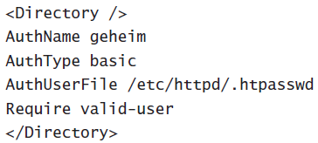

Slide 24
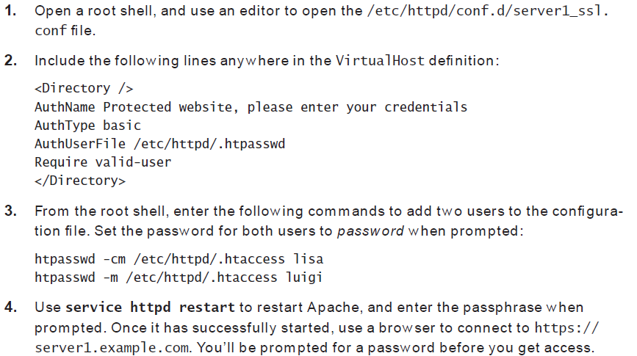
Setting Up a Protected Web Server

Slide 25
Configuring LDAP Authentication
Add user accounts to an LDAP server and configure your Apache server to get the credentials from LDAP.
First the Apache server must be able to handle the LDAP certificate, and the basic authentication provider must be set to LDAP
Next the (virtual) server itself must be configured to use LDAP for authentication.

Slide 26
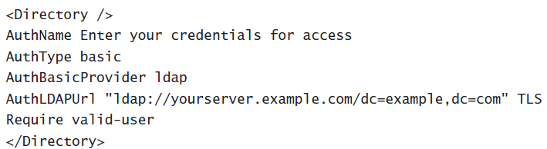

Slide 27
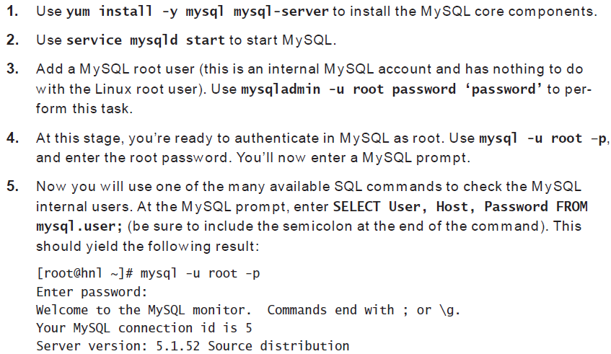
Setting Up MySQL

Slide 28
